Slide 1
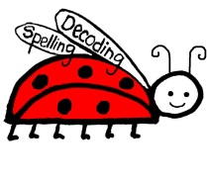
The Power of Chunks in ELL Instruction
Presenters: Christine Marks & Amy Fink
Chunk Reading Program
By Ladybug Literacy
Notes:
Welcome
Do you know what chunks are?
A quick informal survey – what kind of program you are using? Specific to ELLS?

Slide 2
What is most often missing?
Students need Multiple Word Attack Strategies
Students need highly developed phonemic awareness (the best predictor of reading success) -- ELLs particularly struggle to hear difference between short vowels
e.g. S-I-T vs. S-E-T
Phonics instruction should not be too rules-focused
Phonics instruction needs to be integrated/coordinated with text and writing
Multisensory instruction!
Notes:
Several Specific Problems I have noticed over many years working as a classroom teacher and reading specialist.
1) Weakness in phonics skills/decoding most often the problem in struggling readers – no word attack skills. Kids would start the word and then guess. (e.g. “committee”) Kids were taught to guess based on meaning but this is a weak spot for ELL
2) If there was phonics, a lot of time was spent on short and long vowel sounds and students were taught to “sound out” words. But ELL students had a lot of trouble hearing the difference between short vowels in isolation. So this was not a productive approach
3) The few phonics programs were too rules-focused whereas accomplished readers (most adults) really just notice word parts that are similar to other word parts they already know – automaticity. We know even very young kids can hear word parts (e.g. rhymes) so this method is available to them.
4) We all know good writers are good readers, but couldn’t really find a program that developed writing along with the reading. Hearing sounds in dictation (phonemic awareness) develops this skill
5) Most programs tended to be dry. Multisensory is more engaging, has a better chance of connecting with a student because it activates more parts of the brain, and is therefore more memorable.
Didn’t see any curriculum out there that explicitly addressed these issues so I developed my own program about 15 years ago. Since then it has been field tested by me and many others in just about every learning situation (mainstream, Sp.Ed, ELL small group, 1-1 tutoring, home school, adult literacy). We have continued to develop it and add new elements over the years until today we have a very complete reading program.
*Now we are going to look at the elements and strategies identified by Reading Panel of 2000 as necessary in a effective reading program and see how they are implemented in the program we developed.

Slide 3
National Reading Panel of 2000
Largest, most comprehensive evidence-based review
“In summary, deep and thorough knowledge of letters, spelling patterns and words and of the phonological translations of all three, are of inescapable importance to both skillful reading and its acquisition. By extension, instruction designed to develop children’s sensitivity to spellings and their relations to pronunciations should be of paramount importance to the development of reading skills. This is, of course, is precisely what is intended of good phonic instruction.”
--Marilyn Adams (panel participant)

Slide 4
Five Components of Reading
The National Reading Panel of 2000 Recommendations:
Phonemic Awareness
Phonics
Vocabulary
Fluency
Comprehension
2002 National Literacy Panel on Language Minority and Youth was followed up the Reading Panel of 2000 to focus on the special needs of ELLs
Notes:
“United States (e.g., the National Reading Panel, 2000), the United Kingdom (e.g., the Rose Review; Rose, 2006), and Australia (e.g., the Department of Education, Science and Training, or DEST; Rowe, 2005). These reviews have revealed a strong scientific consensus around the importance of phonics instruction in the initial stages of learning to read. “ – Ending the Reading Wars
“Yet reading scientists, teachers, and the public know that reading involves more than alphabetic skills. To become confident, successful readers, children need to learn to recognize words and compute their meanings rapidly without having to engage in translation back to sounds.” – Ending the Reading Wars [i.e. Language coupled with phonics is critical, esp with ELL]
“All writing systems are a kind of code for spoken language,” (so phonemic awareness is extremely important)
Of interest here, however, is how decoding develops once the alphabetic insight has occurred.
The evidence for the effectiveness of phonics instruction is extensive and has been surveyed comprehensively…Phonics instruction improved decoding, spelling, and text comprehension…. More recently, two meta-analyses have concluded that phonics instruction is an effective intervention for poor readers
[Phonics mandated in England, so possible to measure effect] on a national scale, The evidence from performance on the phonics screening check suggests fairly dramatic year-over-year improvements in children’s phonic knowledge since 2012, when the test was introduced: 58% passed in 2012, 69% in 2013, 74% in 2014, 77% in 2015, 81% in 2016, and 81% in 2017
cracking the alphabetic code is essential for learning to read and that assisting children to do so is a nonnegotiable part of teaching them to read…However, the acquisition of phonic knowledge is by no means all there is to learning to read, even at the single-word level…
what changes as a result of exposure to printed words: lexical quality. Perfetti defines lexical quality as the extent to which a stored mental representation of a word specifies its form and meaning in a way that is both precise and flexible…. as lexical quality builds, cognitive resources are freed up for comprehension.
***WE ALL NOW GET IT, THAT PHONICS IS IMPORTANT.
NOW, WHAT IS THE BEST WAY TO DELIVER PHONICS CURRICULUM TO LEARNERS
1) EXPLICIT: explicit teaching of phonics assists all children to access text material relatively early in reading instruction and that this explicit instruction is particularly vital for some children
2) SYSTEMATIC: strong scientific consensus on the effectiveness of systematic phonics instruction during the initial periods of reading instruction…the key ingredient of a successful phonics program is that it is systematic.
3) HF WORDS: the judicious selection of a small number of sight words for children to study in detail has its place in the classroom alongside phonics.
4) DECODABLE TEXT: phonics teaching is more effective when children are given immediate opportunities to apply what they have learned to their reading (Hatcher, Hulme, & Ellis, 1994); so, for these reasons, we believe that there is a good argument for using decodable readers in the very early stages of reading instruction.

Slide 5
Elements of Effective
Phonics Instruction
Explicit
Systematic
HF words
Decodable Text
Castles, A., Rastle, K., & Nation, K. (2018). Ending the Reading Wars: Reading Acquisition From Novice to Expert. Psychological Science in the Public Interest, 19(1), 5–51. https://doi.org/10.1177/1529100618772271
Notes:
MY EXPERIENCE: Meaning + Structure + Visual (graphemic) --> Visual, WHICH IS USUALLY WEAK, is the one strength ELL student have!!!
From Ending the Reading Wars
EXPLICIT: explicit teaching of phonics assists all children to access text material relatively early in reading instruction and that this explicit instruction is particularly vital for some children. … In summary, it is clear that the fundamental insight that graphemes represent phonemes in alphabetic writing systems does not typically come naturally to children. It is something that most children must be taught explicitly, and doing so is important for making further progress in reading. Fortunately, however, the foundational knowledge required to trigger this insight is not extensive and, once acquired, puts children on a path to accruing further knowledge and firmly establishing their alphabetic decoding skills.
SYSTEMATIC: strong scientific consensus on the effectiveness of systematic phonics instruction during the initial periods of reading instruction…the key ingredient of a successful phonics program is that it is systematic. …the rationale for systematic phonics instruction is that a relatively small body of knowledge of how graphemes relate to phonemes provides children with the ability to decode most words in their language.
HF WORDS: the judicious selection of a small number of sight words for children to study in detail has its place in the classroom alongside phonics.
DECODABLE TEXT: phonics teaching is more effective when children are given immediate opportunities to apply what they have learned to their reading (Hatcher, Hulme, & Ellis, 1994); so, for these reasons, we believe that there is a good argument for using decodable readers in the very early stages of reading instruction.
cracking the alphabetic code is essential for learning to read and that assisting children to do so is a nonnegotiable part of teaching them to read…However, the acquisition of phonic knowledge is by no means all there is to learning to read, even at the single-word level…

Slide 6
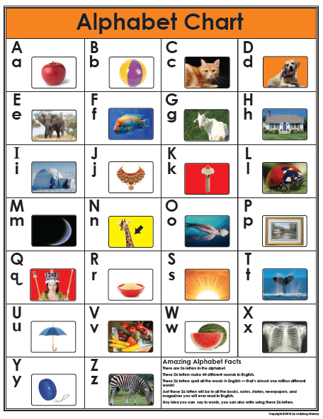
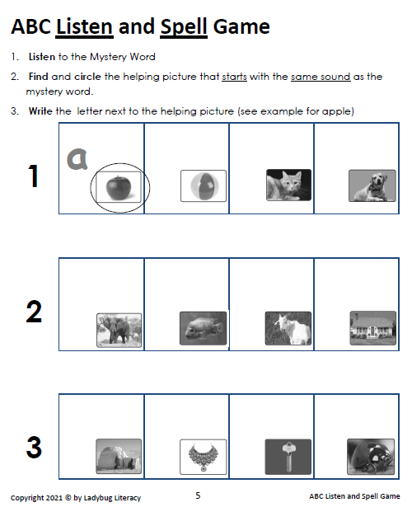
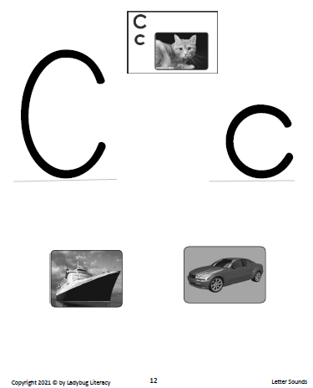
Building Blocks of Literacy
Letter-Sound Correspondence
Reference Chart
Phonemic Awareness
Self-monitoring skills
Group Activity
Phonemic Awareness Desk Work
Phonemic Awareness Activity
Photos help build language for ELLs!
Notes:
Alphabetic Principle
This unit teaches the important Alphabetic Principle. It teaches students that letters they see
stand for particular sounds. This foundation of knowledge (that letters “stand for” sounds), is
critical to being able to read. This unit also introduces students to vowels and helps build
phonemic awareness of different vowel sounds.
The pictures in Skills Book 1 are great for building vocabulary, especially for students who are
learning English as a second language.
*The ABC Module also introduces some prompts, skills, and games that will be used again and
again, in different ways, throughout the entire Chunk Reading Program curriculum:
1) Helping picture
2) Reading Finger
3) Break it with your voice
4) Find it! game
5) Listening Game
6) Self-monitoring (“Give it a test”)

Slide 7
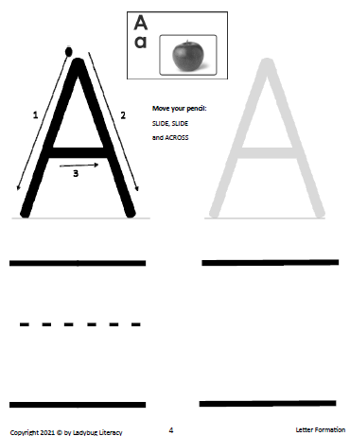
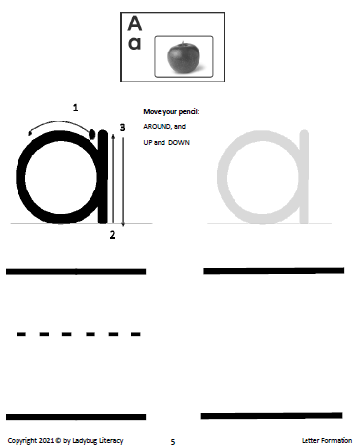
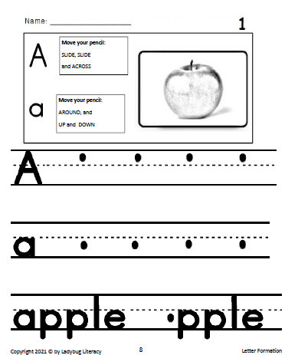
Letter Formation
Letter formation is a crucial multisensory activity that is well-worth the time!
It focuses students on the characteristics of each letter, for deep learning.

Slide 8
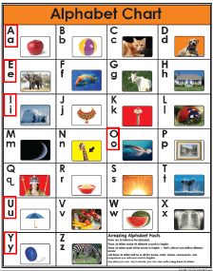
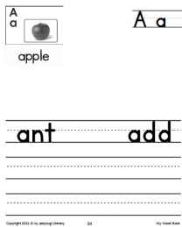
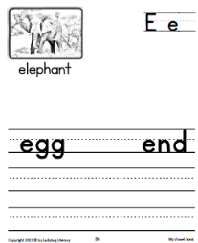
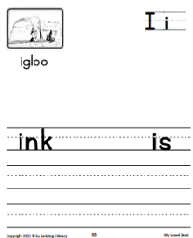
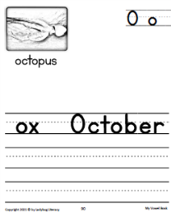
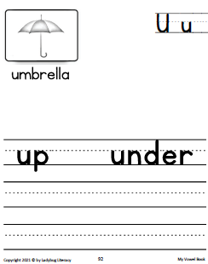
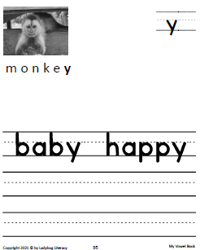
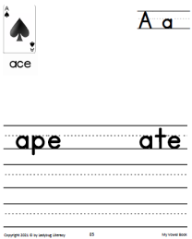
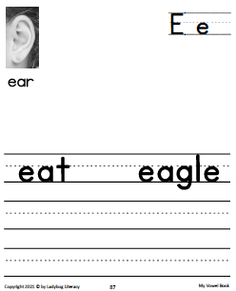
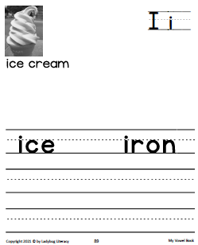
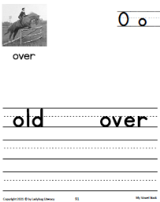
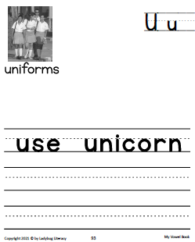
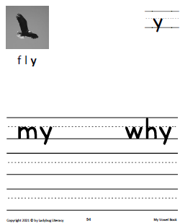
Vowel Sounds
My Vowel Book (desk work):
Useful words with long and short vowels + more writing practice
Group Listening Activity (long or short? + ID the vowel):
Long sound in rhyme Short sound in rhyme
I’m sorry we were late A helpful man
We couldn’t get through the gate Says “yes I can”
We planted many seeds The game’s not over; don’t go in.
But all that grew were weeds! Let’s keep playing ‘til I win.
Notes:
My Vowel Book (Desk Work): examples of words with long and short vowel sounds and more letter writing practice.
Group Listening Activity: Read aloud the fun rhyming couplets on p.18‐19 of this manual to help
students develop their ear for long vs. short vowel sounds. Do one vowel at a time and switch around
between short or long sound rhymes.
Show Me What You Know: After doing 2 or 3 couplets that rhyme, try substituting a word that doesn’t
rhyme (e.g. “I’m sorry we were late, we couldn’t get through the door.”) and kids give thumbs down or
shake their heads or give some other physical indication that they recognize the two words did not rhyme.
IN SUMMATION
Core Standards in ABC Module:
Alphabetic Principle
‐ Letter names, letter formation, consonants and vowels
Phonemic awareness
‐ 1‐to‐1 correspondence: letter/sound
‐ hearing and identifying long and short vowel sounds

Slide 9
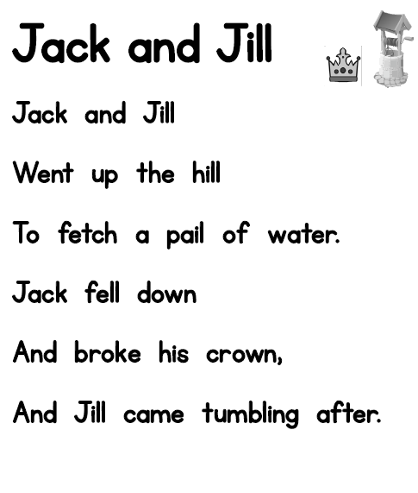
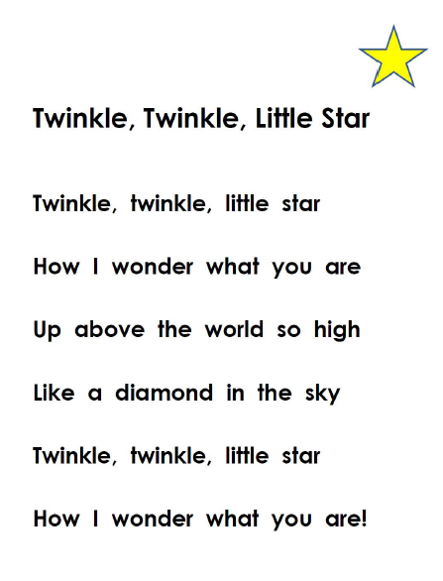
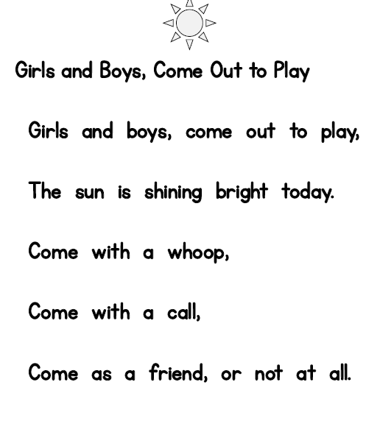
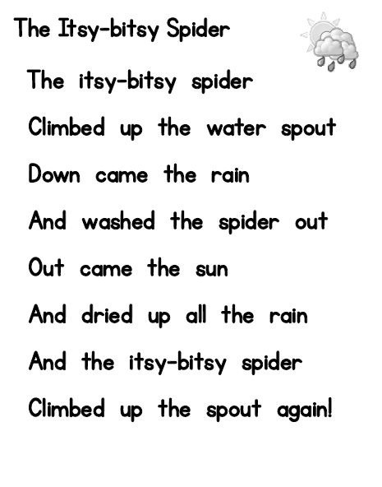
Concepts of Print - 1
High Frequency Word Chart
(BR / ER Curricula)
Nursery Rhymes
(BR / ER Curricula)
Students still mostly working on whole word level
along with beginning sounds at this point.
Notes:
CORE STANDARDS (BR and ER curricula)
Concepts of print—HF Chart and poems address:
what is a word + first and last letter of word
First word of a sentence
Spaces between words
2) left to right reading direction, and “sweep” back to next line
3) capital letter, lowercase letter
4) punctuation
5) one‐to‐one correspondence, pointing to each word they say
6) what is text?
Use the High Frequency Words chart to assess. For any particular word
on the chart, students should be able to:
1) find it 100% of the time
2) read it 100% of the time
3) spell it 40‐50% of the time
As students move into the nursery rhymes and stories, they will encounter the HF words again and again
NOTE that this unit revisits some activities / skills from the Letter Sounds unit:
Find it! Game
Beginning letter sounds

Slide 10
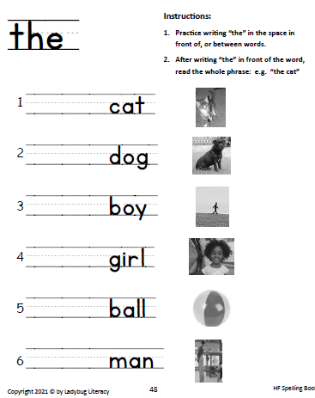
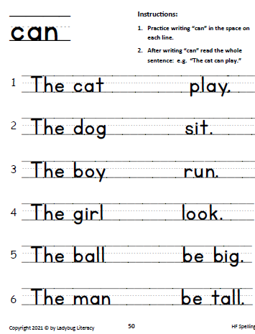
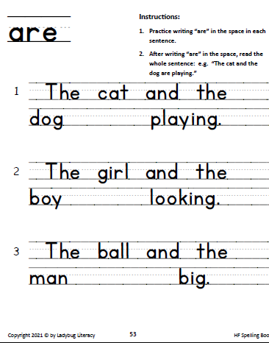
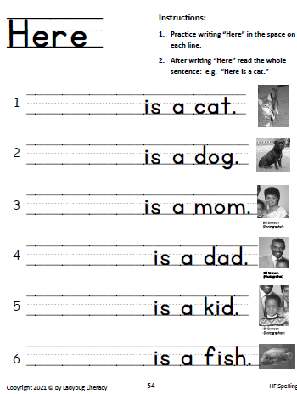
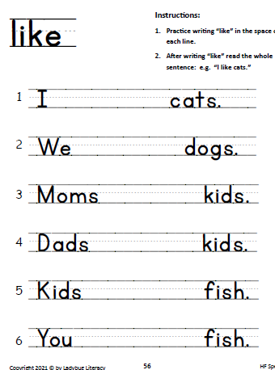
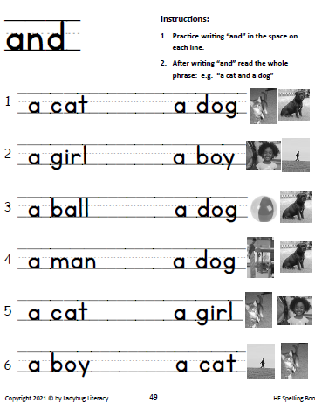
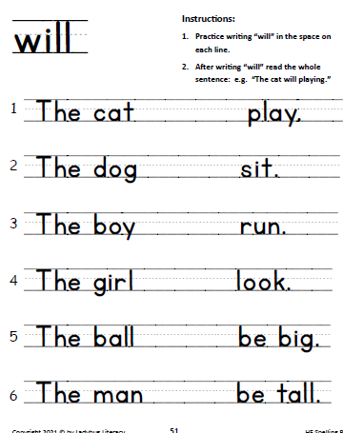
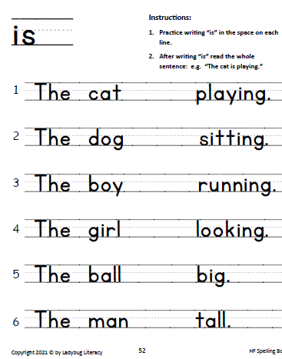
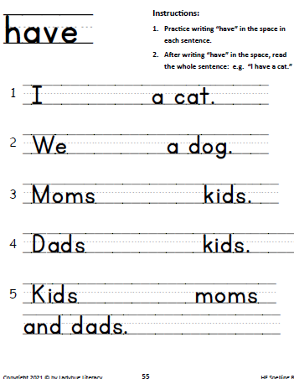
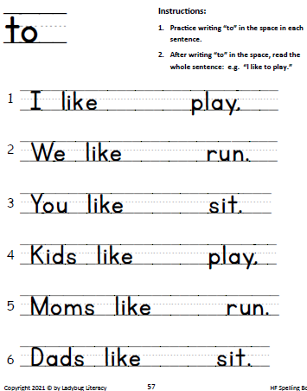
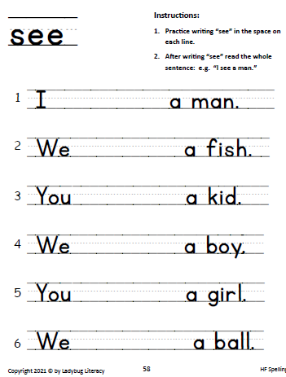
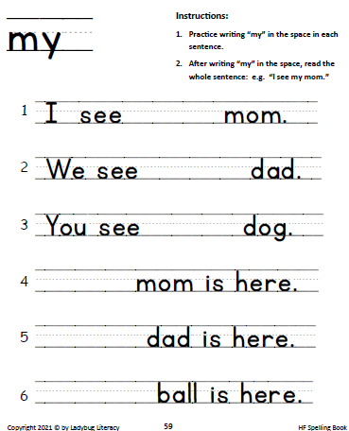
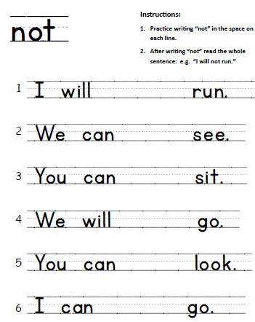
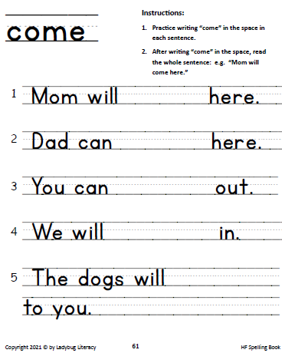
Concepts of Print - 2
Reading and Writing: Sentence Builder
Work with HF words, Language, and Letter Formation continue unit activities.
Notes:
Reinforce concepts taught in HF Chart and Nursery Rhymes
Using writing so that student has to:
- Put a space between words
- Pay attention to upper and lowercase

Slide 11
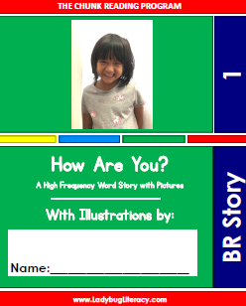
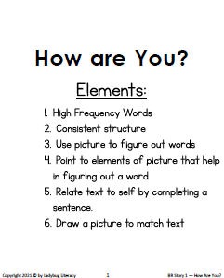
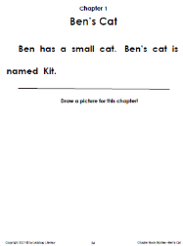
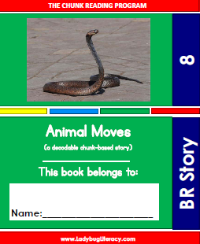
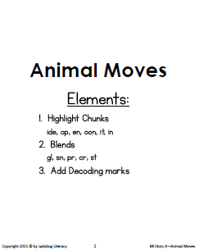
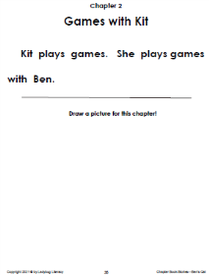
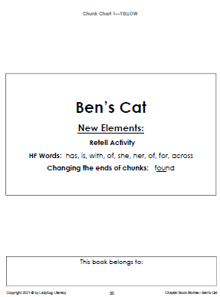
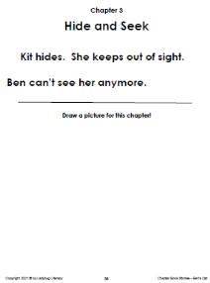
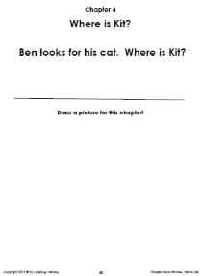
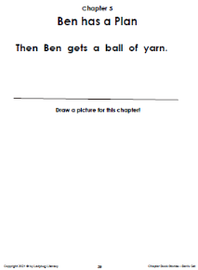
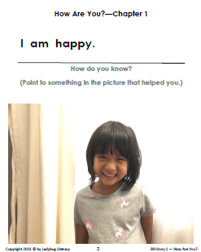
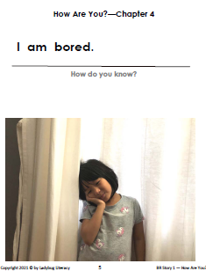
















Concepts of Print - 3
Beginning Reader Stories 6-10 (right):
Same features as books 1-5, but also:
Blends / Digraphs
Chunks
Decoding Marks
Complete illustration to match text
Direct Answer Quiz Questions
BR Books
ER Books
*Stories gain in complexity as students move beyond concepts of print
Notes:
CORE STANDARDS related to Concepts of Print in BR Curriculum
Cover / Front of book
Title
Chapter Headings
Page Numbers
First / last word of a sentence
Punctuation
Indented first word
Spaces between words
Start and end of a sentence
Beginning Reader Stories 1-5 (left):
HF Words
Consistent Structure
Use picture to help figure out words
Sentence Structure (capitalization, spaces, punctuation)
Book features:
- Title
- Chapter headings
- Page numbers
- Relation of Illustration to text
__________________________
CORE STANDARDS relating to Concepts of Print in ER Curriculum
Cover + back of book
Title
Chapter headings
First / last word of a sentence
First / last letter of a word
Text direction
Sweep of the text
Punctuation
Indented first line
Understanding relationship of illustrations to text
ER STORY FEATURES
Large print
Clean, kindergarten font
Less text per page
Chapters
Students supply illustrations to demonstrate comprehension

Slide 12





Blending Letter Sounds
(Getting past the first letter)
*The Blend Module starts with the Sound Game
(students listen for 1 or 2 sounds at the beginning of a word)
Notes:
Intro Blends via THE SOUND GAME, a good multisensory game that uses gestures to help tune students’ ears to blended sounds at the beginning of a word
Revisits Skills / Concepts from ABC Module
Beginning sound of a word
Break the word with your voice
Listening Game (“Give it a test” to self-monitor)
Desk work (Listening Game extension)
Blend Module adds new skills
1) Looking/reading past the first letter of a word
2) Using a decoding mark: a scoop or smile under blends and digraphs
BLEND TO THE END extends the skill through the rest of the word
CORE STANDARDS in BLEND MODULE
•  Phonemic awareness (1‐to‐1 correspondence: letter/sound; digraph/sound; + written/spoken word)
•  Hear, recognize, and name letters
•  Write lowercase letters
•  Isolate and blend consonant sounds
•  Segment or separate beginning sound of word (“break it with your voice”)
•  Blending letter sounds into a word

Slide 13
Best practice for ELL instruction
“Multisensory Mapping uses all modalities (auditory, visual, kinesthetic-tactile) to facilitate retention and processing of sounds. Research confirms that the most common barrier to acquisition of emergent reading skills is the inability to process phonologically.”
--Based on research of Snow, Burns, & Griffin, 1998
In the Chunk Reading Program, students manipulate magnetic letters, chant, sing, and do hand motions to form a memory trace in addition to writing.

Slide 14




Chunk Phonics
Using Letter Patterns / Rimes*
Chunk Charts 1 - 4
The HEART of the Chunk Reading Program
*Rime is another word for Chunk!
Notes:
Core Standards
Phonemic
•  Hear different parts of a word (onset + rime) “Break it with your voice”
•  Recognize and produce rhyming words orally
•  Count, pronounce, blend, and segment parts in spoken words
•  Blend and segment onsets and rimes of single‐syllable spoken words
•  Orally produce single‐syllable words by blending sounds (phonemes), including consonant blends
•  Add or substitute individual sounds (phonemes) in simple, one‐syllable words to make new words
Graphemic
•  Use analogy strategy to recognize common letter patterns or Chunks
•  Use analogy strategy to decode single syllable words
•  Use analogy strategy to generate single syllable words with known Chunks or letter patterns
•  Decode and encode bigger words with multiple Chunks.
Segment long printed words into syllables in order to decode, then blend back into whole word.
_____________________________________
Rimes/Chunks in our program’s 4 Chunk Charts were drawn from research by Marilyn Adams + Wylie and Durell
Chart features
Strong visuals
Photos, not drawings
Concrete helping words
Diversity in images
We will talk more about the features of each chart as we go through our program strategies and you can appreciate how each skill systematically builds upon previous skills.

Slide 15
Why Chunks?
Marilyn Adams (1990) tells us that letter-sound correspondences are more stable when one looks at rimes* than when letters are looked at in isolation.
She noted that of 286 phonograms that appear in primary grade texts, 95% of them were pronounced the same in every word in which they appeared.
at
c at
s at
Just as students must know their ABCs by heart, they must also know the common letter patterns, or chunks, in order to be efficient readers.
They learn the chunk in one word [the helping word], and by analogy to that word, they know what the chunk should sound like in other unknown words.
*Rime is another word for Chunk!
Notes:
64 Letter patterns in our program cover most prevalent spelling patterns students see in K-3 literature! Well worth the time!
Learning these patterns outright, in the same way we learn our letter sounds, is the most efficient way to become fluent readers
- many letter patterns sound the same all the time or nearly all the time
- these consistent patterns show up in most of the words students K-3 encounter
- so it makes sense to learn them

Slide 16
Analogy-based Phonics Benefit ELLS
“For ELLs, who are learning to read in an inconsistent orthography like English, instruction using analogy-based phonics provides children an additional strategy for reading a larger number of words as they are building their English oral language skills. -- Sylvia Linan-Thompson and Sharon Vaughn
(based on data from Blevins, 1998; Center for the Improvement of Early Reading Achievement [CIERA], 2001; NRP, 2000; Texas Education Agency [TEA], 2000).
Notes:
I mentioned at the start of this presentation, that students rely on these cues:
Meaning
Structure
Visual
Visual (i.e. the print itself) is where most students are weak.
But for ELLS, Visual cue is a relative strength. Good to capitalize on that!

Slide 17
Chunk-based Analogies are Easiest!
“…analogies based on rime are easier than those that cut across onset and rime.”
-- Goswami & Bryant 2016
Rime
onset + rime
onset + rime
m eat
s eat
Easy for students→
NOT Rime
mea t
mea n
Difficult for students→
NOT Rime
m ea t
m ea n
Difficult for students→
Once students are secure working with chunks (aka rimes), teach them how to “extend the chunks”
Students learn they can add letters to chunks, drop the last letter of some chunks, and also change the last letter, and the helping word will still help them figure it out.
Notes:
Students have an easier time recognizing a word part when you change the onset than when you change the end.
We will talk about how to do this in a few minutes!

Slide 18
Features of
Chunk Charts in
The Chunk Reading Program
Notes:
ATTENDEES CAN GO THROUGH THESE NEXT 4 SLIDES, LATER ON THEIR OWN

Slide 19

Elements of Chunk Chart 1
All short vowels are represented
“Silent e” appears in 3 chunks
Students recognize images and words from ABC and Blend charts (e.g. cat, stop, slide, moon, etc.)
Reinforcing Blends and Digraphs via Chunk Charts
Multisensory mapping of chunks through visuals, chanting, cheering, and breaking words with their voice
Notes:
Chunk = Second part of a word
Chunk Cheer Daily Warm-up
Quick and helps with memorizing chunks

Slide 20

Elements of Chunk Chart 2
Soft c rule is introduced
Silent e introduced
(-at vs. –ate)
Two vowels rule introduced
9 chunks offer good practice for dropping and changing last part of a chunk

Slide 21

Elements of Chunk Chart 3
Review of two vowels rule
2nd sound of –ow
(cow vs. snow)
2nd sound of -oo
(moon vs. book)
Pattern -ture
10 chunks offer good practice for dropping and changing last part of a chunk
5 chunks ending in k push students to discriminate by mentally dropping the last letter
Revisit silent -gh
(-ight & -aught)

Slide 22

Elements of Chunk Chart 4
Pattern: –tion
2nd sound of –ea
(meat vs. bread)
Revisit soft c / soft g rule (badge)
Pattern –dge is taught through the rime or chunk –adge
Mix of hard and easy concepts keeps students confident as they master new reading and writing skills

Slide 23
Teaching the Chunks – 1
Breaking words (Phonemic Segmentation)
Breaking words
- with voice (onset + rime)
- with hands into 1st part + 2nd part
- with voice and hands in Chunk Cheer
(use Sound Game finger motions for blends)
- with magnetic letters (1st part + 2nd part)
Secret of the Chunk
“keep the chunk and change the first part”
Chunk Call and Response Game
c at
c at → s at
1st
part
2nd
part
Notes:
As you will have noticed, this program gives A LOT of attention to phonemic awareness and phonemic segmentation. These are the foundation of strong reading skills:
Researchers “sound in” on Phonemic Awareness:
Juel: found that phonemic awareness is an important precursor to reading success.
Yopp and Yopp: found that phonemic awareness correlates with reading success.
Kate Nation: found “a large body of research on the importance of the metalinguistic skill of phonemic awareness in reading acquisition”
How our program builds phonemic awareness:
Blend Song
Chunk Cheer
Sound Game
Listening Games (ABC, Blend, and Chunk)
Long/Short vowel sound couplets
Phonemic segmentation activities (chunk cheer)
Chunk Call and Response Game
________________________________________________
Hearing Rimes or Chunks (phonemic segmentation)
Magnetic Letters: Breaking Words & Modeling How Chunks Work
The Chunk Listen and Spell Game
Playing the Match‐O Game, part 1
Playing the Match‐O Game, part 2
Magnetic Letters: Mystery Word of the Day
Chunk Chart 1: Chunk Call and Response Game
Skills Practice 5 Book: Shared Writing
_______________________
CORE STANDARDS IN CHUNK MODULE
Recognizing patterns or Chunks
Generating new words with familiar Chunks
Writing mechanics
•  punctuation
•  capitalization
•  spaces between words
•  indentation

Slide 24

Teaching the Chunks – 2
Applying the Secret of the Chunk
2 new decoding marks taught
Great lead-in to next activity!
Revisits skills learned in ABC and Blend Modules
Notes:
Hearing Rimes or Chunks (phonemic segmentation)
Magnetic Letters: Breaking Words & Modeling How Chunks Work
The Chunk Listen and Spell Game + new decoding mark!
Playing the Match‐O Game, part 1
Playing the Match‐O Game, part 2
Magnetic Letters: Mystery Word of the Day
Chunk Chart 1: Chunk Call and Response Game
Skills Practice 5 Book: Shared Writing
_______________________
CORE STANDARDS IN CHUNK MODULE
Recognizing patterns or Chunks
Generating new words with familiar Chunks
Writing mechanics
•  punctuation
•  capitalization
•  spaces between words
•  indentation

Slide 25







Teaching the Chunks – 3
Playing the Match-O Game
s a t
Transition from Listening Cues to Visual Cues
Notes:
Leveled Word Lists 1 through 5 for Chunk Chart 1 shown here
Words get more complex with each level, but students know if they “chunk it out” they can read it!
Leveled Lists are made up of productive words pulled from content, academic word list, synonyms, adjectives
Introduce students to new words with 5 Leveled Lists for each CHUNK Chart
About 75% of list words are encountered again in the stories
Students reference their knowledge of Chunks to spell new words
Match-O grids help students focus on which letter patterns represent which sounds
_______________________
CORE STANDARDS IN CHUNK MODULE
Recognizing patterns or Chunks
Generating new words with familiar Chunks
Writing mechanics
•  punctuation
•  capitalization
•  spaces between words
•  indentation

Slide 26


Teaching the Chunks – 4
Writing with Chunks
Shared Writing
Mystery Word Diary
“Programs should provide ELLs opportunities to spell words and write their own stories with the letter-sound relationships they are learning.”
-- Sylvia Linan-Thompson and Sharon Vaughn
Notes:
Early Writing Activities
Synthesize phonics, writing, meaning.
1) Chunk Writing Pages/Shared Writing: desk work
2) Mystery Word Diary: a powerful daily group warm-up activity!
Mystery word diary helps build vocabulary, and gives students a chance to practice encoding (spelling) complex words.
_______________________
CORE STANDARDS IN CHUNK MODULE
Recognizing patterns or Chunks
Generating new words with familiar Chunks
Writing mechanics
•  punctuation
•  capitalization
•  spaces between words
•  indentation
Mystery Word Diary also helps build vocabulary

Slide 27
Teaching the Chunks – 5
Extending the Chunks
car → cars → cart
Add letters to the end of a chunk
Drop letters from the end of some chunks
Change the last letter of some chunks
Combine Chunk Secret with changing last letter
moon → moo
ball → bald
ball → mall →malt
Once students are secure with the Chunks,
they easily learn to apply analogies that cut across rimes
Notes:
This is where the Decoding Marks REALLY come in handy for teaching and for understanding!!!
And this is how students transition to decoding multisyllabic words
Hearing Rimes or Chunks (phonemic segmentation)
Magnetic Letters: Breaking Words & Modeling How Chunks Work
The Chunk Listen and Spell Game + new decoding mark!
Playing the Match‐O Game, part 1
Playing the Match‐O Game, part 2
Magnetic Letters: Mystery Word of the Day
Chunk Chart 1: Chunk Call and Response Game
Skills Practice 5 Book: Shared Writing
_______________________
CORE STANDARDS IN CHUNK MODULE
Recognizing patterns or Chunks
Generating new words with familiar Chunks
Writing mechanics
•  punctuation
•  capitalization
•  spaces between words
•  indentation

Slide 28
Tackling Longer Words with Chunks
The Mystery Word Diary
(A daily group activity)
intervention
“Learning to convert letters to recognize words requires knowledge of the relation between sounds and letters or other symbols that represent them, then remembering the exact patterns and sequences that may represent various speech sounds.” --Goswami 2006

Slide 29
Students use helping words from Chunk Charts and decoding marks to “PROVE” they decoded the word correctly
win
herd
ten
fraction
in ter ven tion
“…Analogies are a natural and important part of children’s reading and spelling. They are made by old and young children alike—by older children who know how to read and write a great number of words and by young children who can read hardly any words and spell even fewer.
These beginning readers are ready to make analogies even though they know so few written words and therefore have such a small basis for making any analogies at all. Nevertheless, they apply their awareness of rime, and their obvious capacity to make inferences, to the business of learning how to read and spell new words.” – Goswami and Bryant (1990)

Slide 30




Teaching the Chunks – 6
Building Automaticity
Notes:
“In addition [to an analogy-based phonics approach] the program should include books and stories that contain a large number of words that children can decode by using the letter-sound relationships they have learned and are learning.”
-- Sylvia Linan-Thompson and Sharon Vaughn
“These kinds of books provide children with an opportunity to practice what they have been taught explicitly in the classroom and to allow them to experience success in reading independently very early in reading instruction, albeit with a rather restricted word set. These books also allow teachers to effectively structure and sequence children’s exposure to grapheme-phoneme correspondences in text. Evidence suggests that phonics teaching is more effective when children are given immediate opportunities to apply what they have learned to their reading (Hatcher, Hulme, & Ellis, 1994); so, for these reasons, we believe that there is a good argument for using decodable readers in the very early stages of reading instruction.”
From Ending the Reading Wars

Slide 31
Applying Chunks to Text
“In addition [to an analogy-based phonics approach] the program should include books and stories that contain a large number of words that children can decode by using the letter-sound relationships they have learned and are learning.”
-- Sylvia Linan-Thompson and Sharon Vaughn
“These kinds of [decodable] books provide children with an opportunity to practice what they have been taught explicitly in the classroom and to allow them to experience success in reading independently very early in reading instruction, albeit with a rather restricted word set. These books also allow teachers to effectively structure and sequence children’s exposure to grapheme-phoneme correspondences in text. Evidence suggests that phonics teaching is more effective when children are given immediate opportunities to apply what they have learned to their reading (Hatcher, Hulme, & Ellis, 1994); so, for these reasons, we believe that there is a good argument for using decodable readers in the very early stages of reading instruction.”
-- From Ending the Reading Wars

Slide 32




Applying Chunks to Text
Decoding:
Chunk Charts help students learn sounds and letter patterns of 64 common chunks.
Helping words and pictures make the chunks and patterns easy to remember.
Decoding and Spelling:
Students decode new words by recognizing known letter patterns from Chunk Chart, and making analogies to new words in Leveled Lists (moving from known helping words to new words).
Reading:
Students read a story with picture support. The story's decodable text has embedded chunks from all the charts the student has covered to that point.
Spelling:
Students write words from the Leveled Lists in Match-O Game Grids under the matching chunk and helping word.

Slide 33



Applying Chunks to Text – BR 1
Beginning Reader Stories 1-5
High Frequency Words (whole word)
Beginning letter sounds
Using picture to read text
Consistent structure
Clear Kindergarten font and word spacing
Relating text to self
Using text to complete picture
Students work on stories 1-5 while they are being introduced to Blends and Chunks.
Notes:
The program includes many original stories with decodable text from different genres.
All stories include comprehension activities.
The stories get longer and more complex as the students master more chunks.
The most challenging story is about middle of 3rd grade.
Beginning Reader (Pre-K, K)
HF word, predictable stories
- consistent sentence structure
- picture support
- very little text per page
2) Decodable
- HF words
- picture support for undecodable words
- very little text per page
- focus on just a few chunks per book for repeated practice

Slide 34



Applying Chunks to Text – BR 2
Beginning Reader Practice Story (bridge to stories 6-10)
Walks students through applying phonics strategies:
- finding/highlighting Chunks (as in Match-O)
- finding Blends (decoding mark)
- noticing HF words
Comprehension activities:
- use text to complete picture
- quiz question strategy
(finding text in story that matches question text)
Transition Story
For stories 6-10, students will rely mostly on phonics and much less on pictures, HF words, and beginning letter sounds
Notes:
The program includes many original stories with decodable text from different genres.
All stories include comprehension activities.
The stories get longer and more complex as the students master more chunks.
The most challenging story is about middle of 3rd grade.
Beginning Reader (Pre-K, K)
HF word, predictable stories
- consistent sentence structure
- picture support
- very little text per page
2) Decodable
- HF words
- picture support for undecodable words
- very little text per page
- focus on just a few chunks per book for repeated practice

Slide 35





Applying Chunks to Text – ER
Early Reader Stories
Applying phonics strategies:
- finding/highlighting Chunks (as in Match-O)
- finding Blends (decoding mark)
- noticing HF words
Comprehension activities:
- use text to make picture for each chapter
- retell activity
- quiz question strategy
(finding text in story that matches question text)
Building Fluency:
- introduce story via chapter book
- reread story as full page of text
(with or without chunks underlined as needed)
- more text per page with each successive story
ER students are introduced to Blends and Chunks before starting the stories.

Slide 36




Applying Chunks to Text – DR
Developing Reader Stories
Applying phonics strategies:
- finding/highlighting Chunks (as in Match-O)
- finding Blends (decoding mark)
- noticing HF words
Comprehension activities:
- quiz questions require more thinking than ER quiz
- story topics are more complex than ER
- retell activity
-
Building Fluency:
- introduce story via chapter book
- reread story as full page of text
(with or without chunks underlined as needed)
- more text per page with each successive story
DR stories cover different genres and include 17 nonfiction units

Slide 37





Writing with Chunks
Early Reader
Match-O
Chunk Writing Pages
Mystery Word Diary
Comprehension Quiz
* Dictation – hearing and transcribing a few lines of familiar text
Developing Reader
Match-O
Chunk Writing Pages
Mystery Word Diary
Comprehension Quiz
Dictation
*Research Literacy
write search terms for further study
*Writer Workshop
apply result of search to write paragraph
DR stories cover different genres and include 17 nonfiction units.
Each story is a jumping off point for guided research and writing.
Students have the chance to take their learning in their own direction!
Notes:
We have already seen the ways students in our Beginning Reader curriculum have the chance to practice applying new skills to writing.
Our Early and Developing Reader curricula begin to put much more emphasis on writing, following this progression:
Match-O
Chunk Writing Pages (generating words with chunks and using them in a sentence)
Mystery Word Diary (reading multisyllabic words with chunks and writing a sentence with them)
Comprehension Quiz questions (in DR these require more than just copying text from story)
Dictation (hearing and transcribing familiar text)
Research literacy (thinking up and writing search terms for further study, then carrying out the actual search)
Writing workshop (applying what was found in research to develop paragraph writing skills)
__________________________________________________
Dictation
provides explicit instruction in phonemic awareness
reinforces concepts of print, such as left to right, spacing, first and last letter of a word, capitalization, punctuation, swing of print, etc.
provides practice with proper letter formation
secures good reading strategies, such as rereading, making meaning sense and structural sense, and reading with expression
Research Literacy
Reading for knowledge
Writing Workshop
Making learning personal

Slide 38


Writing skills are supported in three different ways!
1. Chunk Writing Pages
There is a writing exercise for every chunk in the program
Dictation Lesson:
provides explicit instruction in phonemic awareness
reinforces concepts of print, such as left to right, spacing, first and last letter of a word, capitalization, punctuation, swing of print, etc.
provides practice with proper letter formation
secures good reading strategies, such as rereading, making meaning sense and structural sense, and reading with expression
3. Story Comprehension Quizzes
Short Answer and Non-Fiction Unit Essays

Slide 39
Show me the data!

Slide 40
2nd grade Somali ELL students - Nov 2018 – May 2019
 | Fall 2018 Form A % |  |  |  | Winter 2019 Form A % |  |  |  | Spring 2019 scores given in %
 | Form A | Form B | Form C |  | Form A | Form B | Form C |  | Form A | Form B | Form C
Abd. | 10 |  |  |  | 75 |  |  |  | 95 | 81 | 63
Fatm. | 75 |  |  |  | 88 | 81 |  |  | 62 | 58 | 43
Zak. | 8 |  |  |  | 30 |  |  |  | 73
Nur. | 50 |  |  |  | 69 |  |  |  | 80 | 70 | 48
Yah. | 50 |  |  |  | 80 | 61 |  |  | 87 | 81 | 70
Mak. | 67 |  |  |  | 80 | 80 |  |  | 81 | 78
Ash. | 70 |  |  |  | 89 | 73 |  |  | 98 | 86 | 72
Dau. | 81 | 70 |  |  |  | 89 | 77 |  | 100 | 98 | 84
Huth. | 39 |  |  |  | 75 |  |  |  | 91 | 91
Rah. | 14 |  |  |  | 28 |  |  |  | 30
Fad. | 25 |  |  |  | 53 |  |  |  | 70 | 59
Han. | 36 |  |  |  |  | 66 |  |  | 95 | 91 | 75
Sac. | 2 |  |  |  | 58 |  |  |  | 50
Uka. | 25 |  |  |  | 52 |  |  |  | 72
Form A : 1-syllable, few blends/digraphs (e.g. sat, more, hill, plow, coat, few, flip, law)
Form B: 1-2 syllables, many blends/digraphs, some endings/compound words
(e.g. shop, steepest, folded, powder, eastern, mixture, failure, thirsty, wrinkle)
Form C: 2-3 syllables, many compound words, many affixes
(e.g. committee, popular, occupation, filtering, precaution, acquaintance, gadget, threadbare)

Slide 41


Slide 42


Slide 43

Results based on 7 weeks of instruction.

Slide 44
NWEA Data Gains, Oct. 2010 – Jan. 2011
These 4th, 5th, and 6th graders completed the Chunk Reading Program in 3 months.
ELL Student | Gains
Jeff | +25
Jessica | +18
Tsion | +16
Elizabeth | +17
Yibeital | +23
Abeal | +19
Jonathon | +15

Slide 45
ELL Students are saying:
ELL Teachers are saying:
“The Chunk Charts helped me brake the word down, sound the word, and read fluently. I was at a low level last year, and this year I got to a high level and read good.”
-- Z., 5th grade ELL student
“After just 8 weeks of teaching, practicing, and applying the Chunk Charts with my students, I have noticed that my ELL have specific strategies for helping themselves by breaking the word apart, comparing the parts to the chunks they know, and decoding the word on their own. I often hear my students say things like, ‘This word has the chunk – old, like old/cold.’ ELL students can access this system automatically because each chunk is directly linked to a helping word and a photo of that word. Furthermore, the helping words are universal concepts that my ELL students have direct experience with.”
-- Sarah Hernandez, ELL teacher
“The Chunk Charts help me get better with reading. I feel great about reading!”
-- A., 5th grade ELL student
“It’s fun to decode with Chunk Charts and with songs too. I learned to break up the word into little pieces and it help me to read better.
-- N., 5th grade ELL student

Slide 46


















Teacher Edition
Beginning Reader
Student Book Set
5 skills books +
10 story books
Early Reader
Student Book Set
Developing Reader
Student Book Set
Game Cards
28 Teaching Videos
Highlighters
magnetic letters

Slide 47
Thank you!!!
Questions
+
View Materials

Slide 48

Notes:
Lesson Plan Framework for Early Reader class

Slide 49



More Fun with Vowel Sounds
Silent E Rule
Vowel Pairs
Vowel Sort Game!
Notes:
Introduce these vowel sound rules with Chunk Chart 2
Silent E rule - cat vs. gate
Vowel Pair rule – cat vs. meat and win vs. train
In other words, the rule overrides the Chunk.
The second they see an e at the end of a word, they need to see if CVE rule applies
The second they see a vowel pair, they need to see if the VV rule applies.
When the vowel pair rule does not apply, there is a specific chunk and helping word that handles that case (e.g. moon, shout, soil, bread)
The Vowel Sort Game gives students a chance to practice with different vowel situations.

Slide 50
Fry’s first 300 sight words:
171 of these contain chunks (many words more than 1 chunk)
In addition, many are covered by the
silent-e rule
Students can apply program strategy of analogies to remember many (e.g. be, me, we, he, she + could, would, should etc.)

